Slide 1

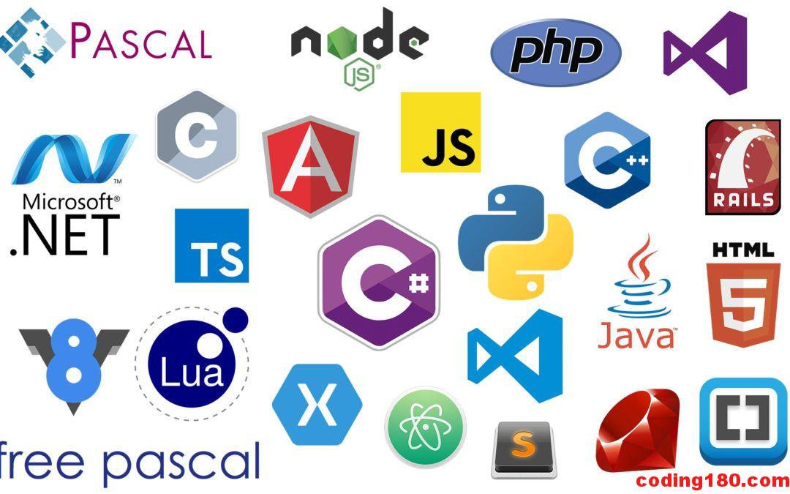
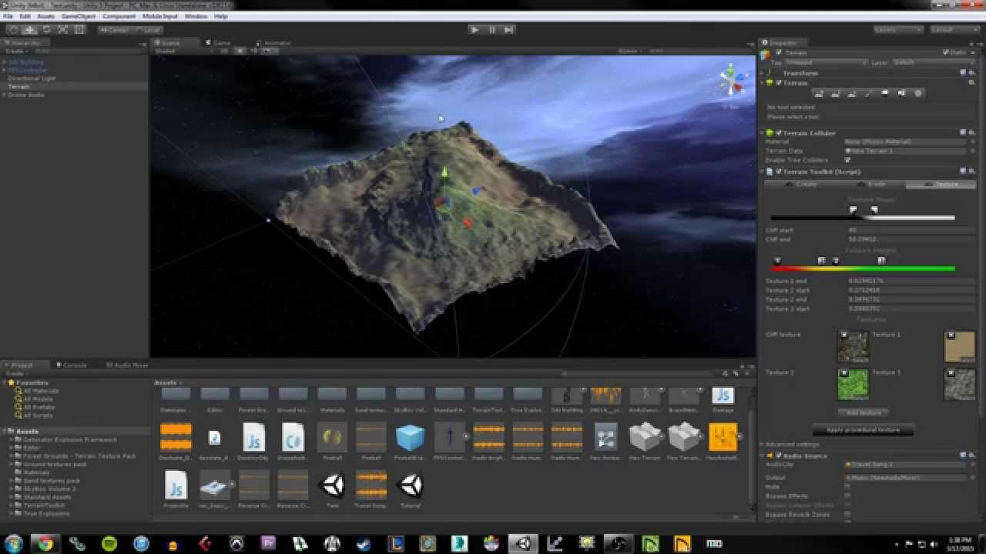
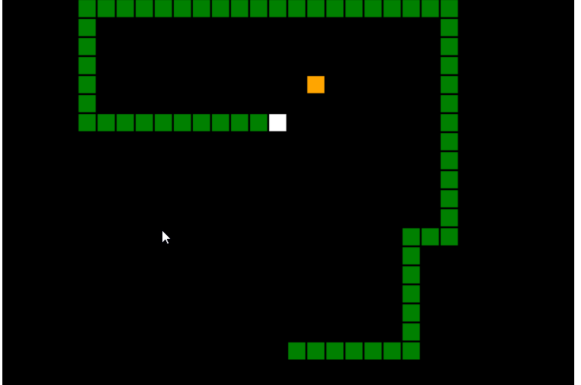
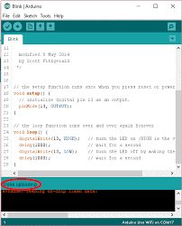
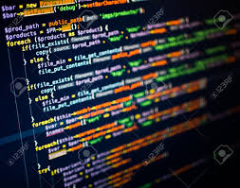
Programming Merit Badge 2

Slide 2

Javascript
Our first Programming Language
Originally developed for browsers
Not related to Java but similar syntax
Focus was on client-side responsiveness
Evolved to server-side processing and other areas
Easy to learn but cumbersome to debug

Slide 3
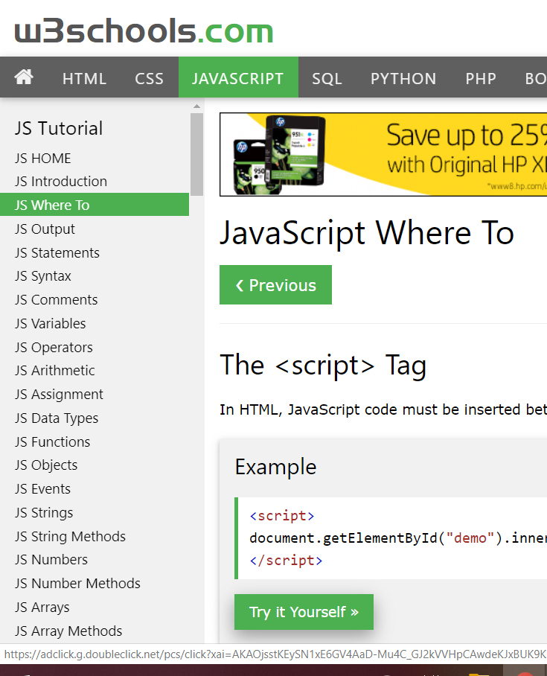
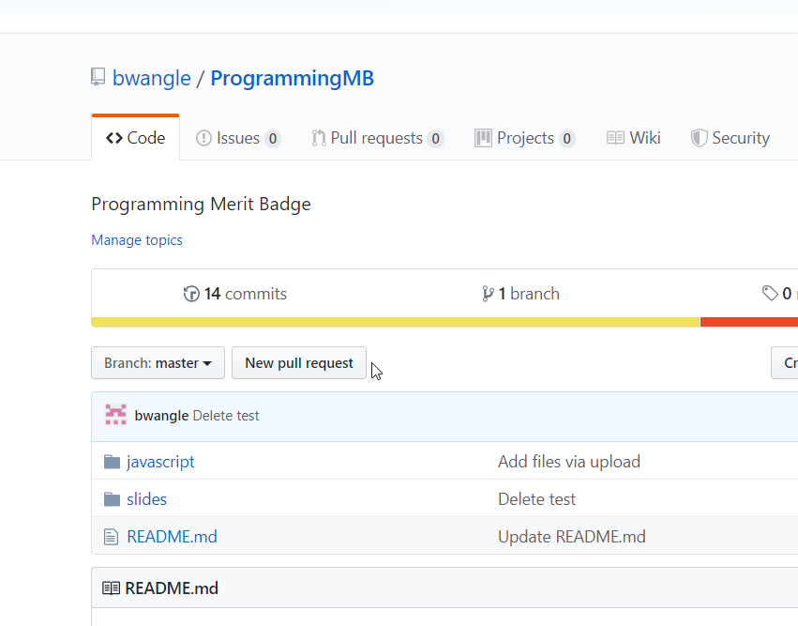
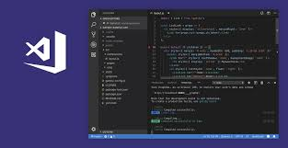
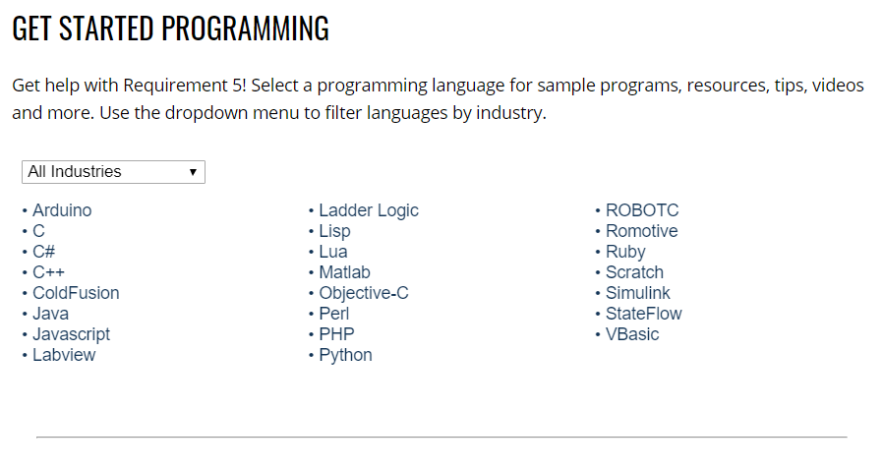
Resources
W3Schools
Boys’ Life Programming Site
My GitHub
VSCode Editor
Other
Your browser

Slide 4
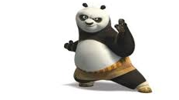
Let’s Get Started
Fire up your computers
Enough Talk – Let’s Code!
Review basics and get moving!

